Slide 1
BL(u)E CRAB:
RSSI Detection Pattern Analysis for Flagging System Development
Zhi Qu

Slide 2
What is the Threat?
Stalking
Making unwanted and persistent phone calls
Approaching or showing up in places uninvited
Following and watching the person
Sending unwanted texts, emails, and social media messages
Delivering unwanted gifts
Utilizing technology for monitoring and tracking

Slide 3
What is the Threat?
Stalking
Making unwanted and persistent phone calls
Approaching or showing up in places uninvited
Following and watching the person
Sending unwanted texts, emails, and social media messages
Delivering unwanted gifts
Utilizing technology for monitoring and tracking

Slide 4
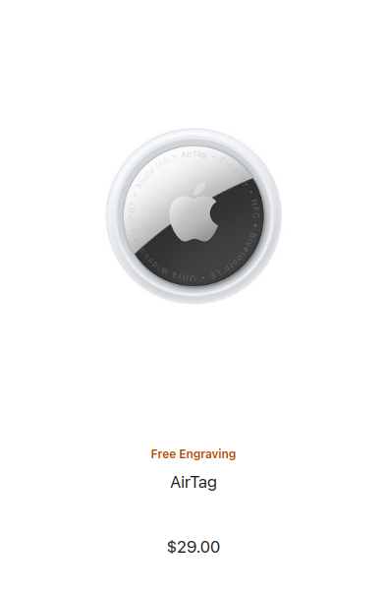
AirTag
Affordable

Slide 5
AirTag
Affordable
Accessible

Slide 6
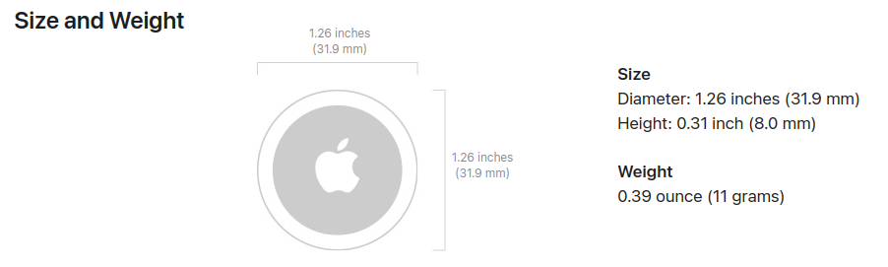
AirTag
Affordable
Accessible
Compact

Slide 7
BL(u)E CRAB
App
Scans for BLE nearby
Logs device info
Assess risk
Flags device

Slide 8
The Code

Slide 9
Reading the data

Slide 10
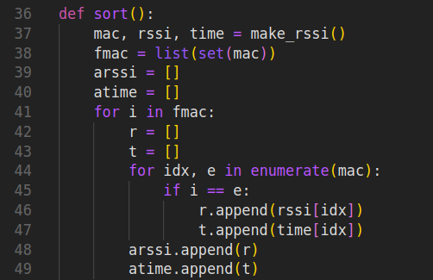
Identifying each mac id

Slide 11
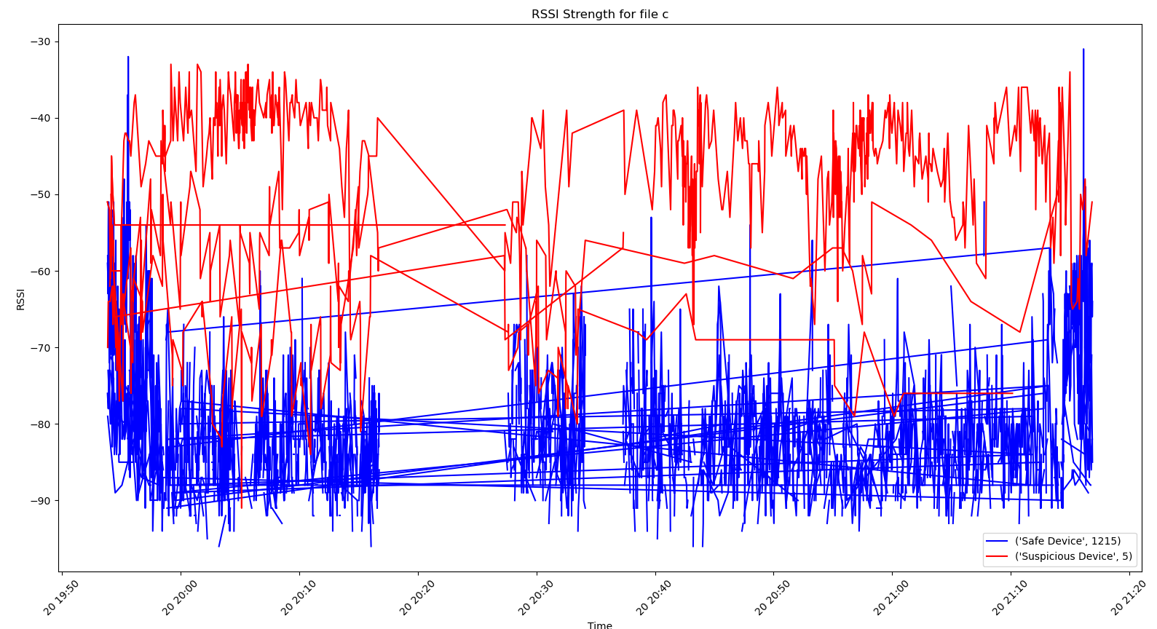
Data file c

Slide 12
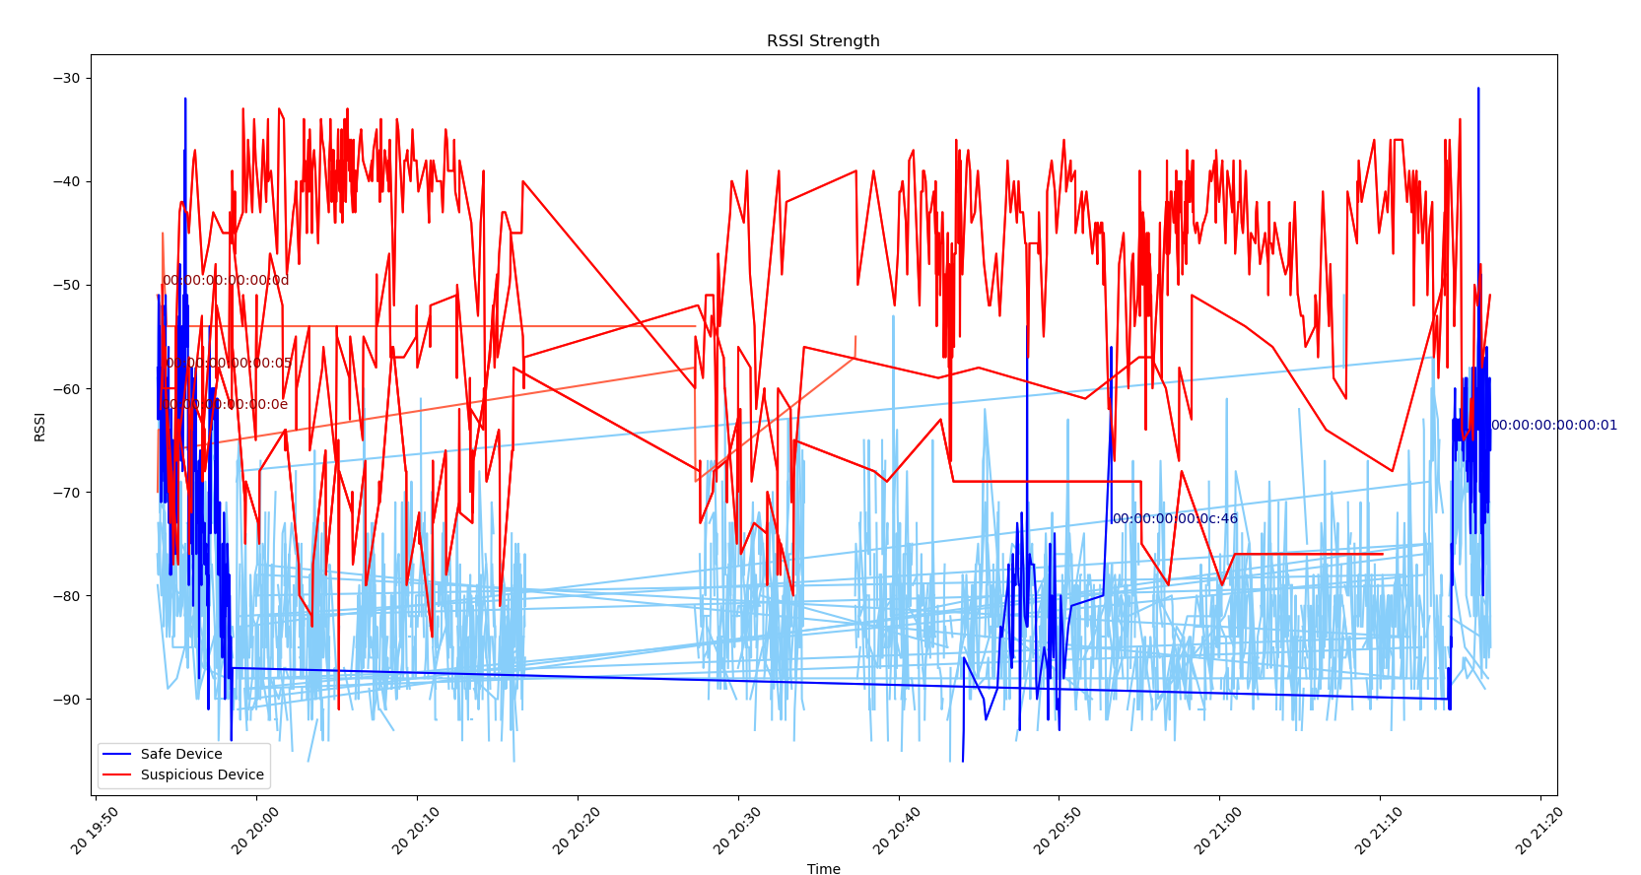
Data file c – long detection

Slide 13
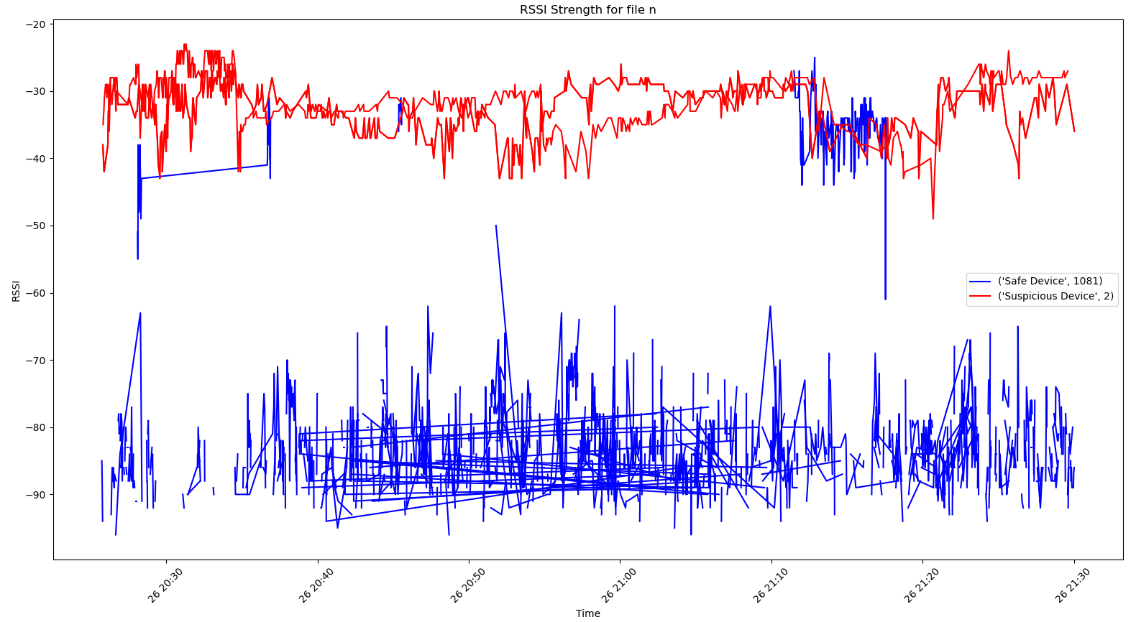
Data file n

Slide 14
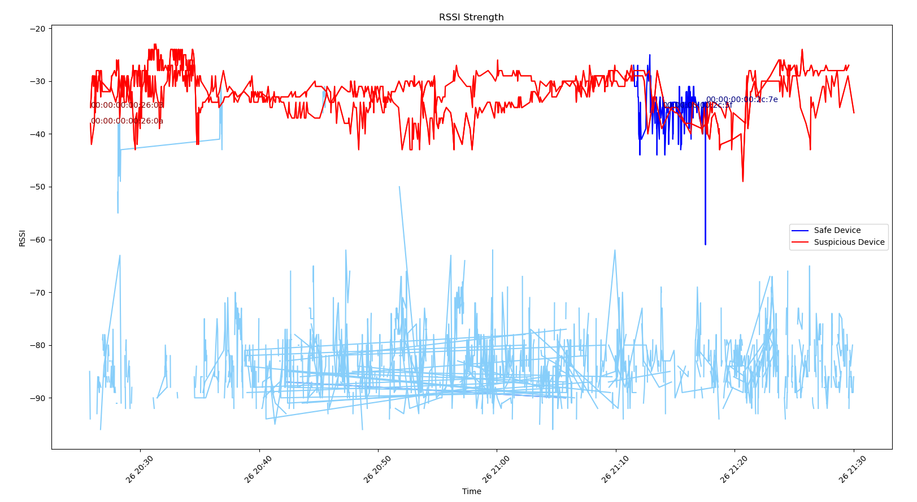
Data file n - long detection

Slide 15
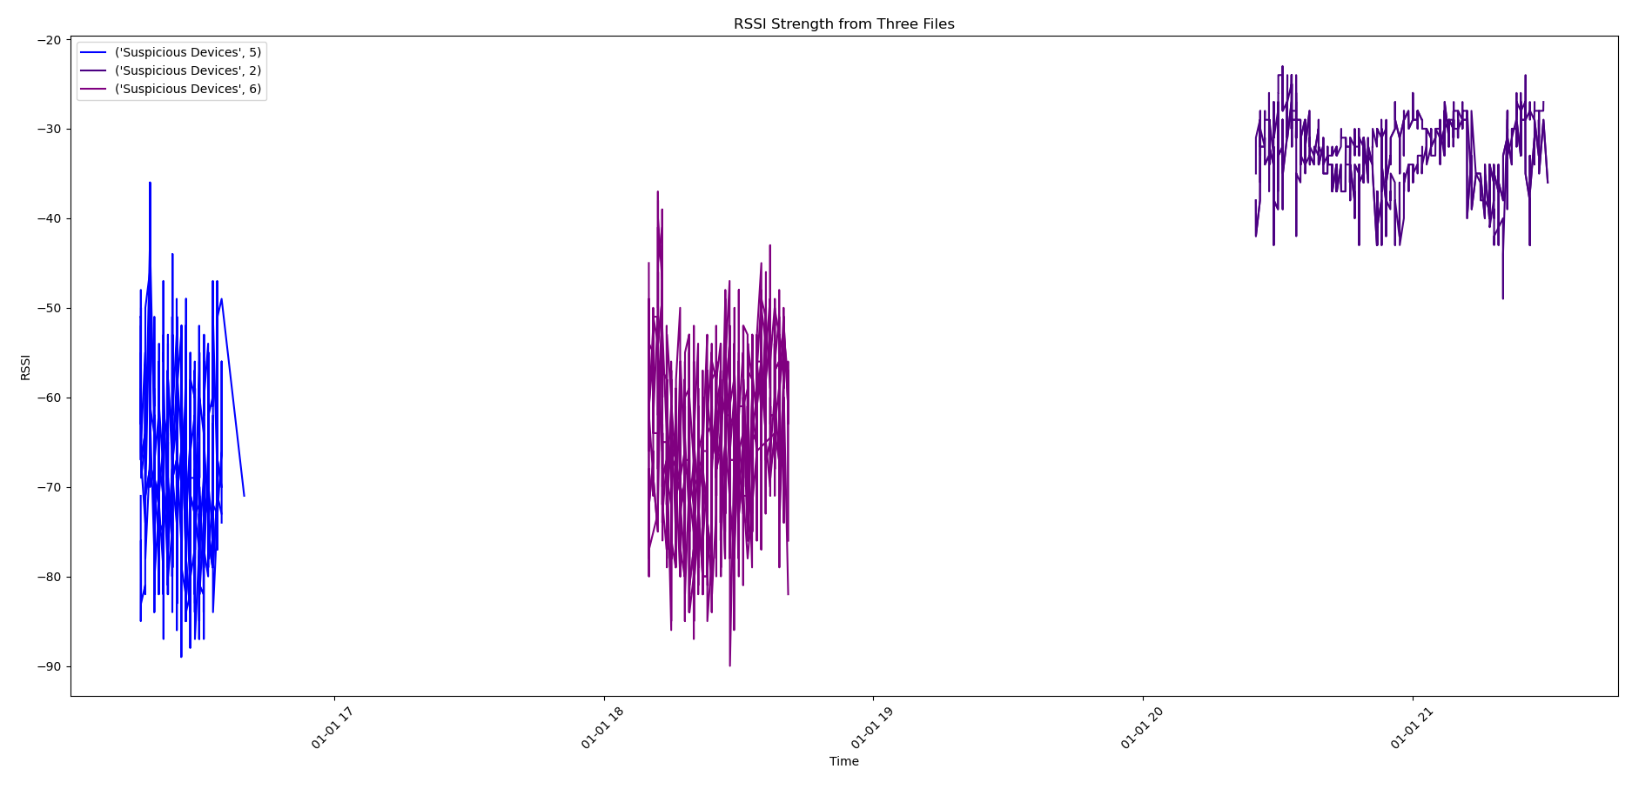
Time of day – G,N,J

